Slide 1
TERMINAL
SSJKV
GROUP 2
Kamal Rimal, Sarah Swilley, Saleh Alhassan, Juan Martinez, Viktoriya Rasuli

Slide 2
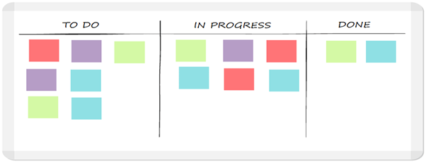
PROBLEM
Plan/Schedule
Hard to separate work among team members.
Some people did have the required skills.
Some team members didn't want to take work and learn new skills.
Schedule deadline to submit the work of each team member.
Some team members always missed the submission deadline work and required to extend.

Slide 3


PROBLEM
Collaboration: GitHub/Slack
It is hard to schedule an online meeting in Slack.
People at work, busy, have the stuff to do on their own.
Bad team communication.
Some people not communicating with other team members.
Some people not responding to the team chat.
Some team members response to messages after several hours.
Find a time for a collective meeting.
Busy schedule and work.

Slide 4
PROBLEM
Development Process
Main problems with the development were figuring out the layout -- the linear path taken through the websites
Trying to figure out a good entry point
Transition pages
Having conflicting ideas about format and necessary webpages
Having database and front-end working separately
miscommunication about how data is being pulled from the database and how it should look on the front-end side

Slide 5
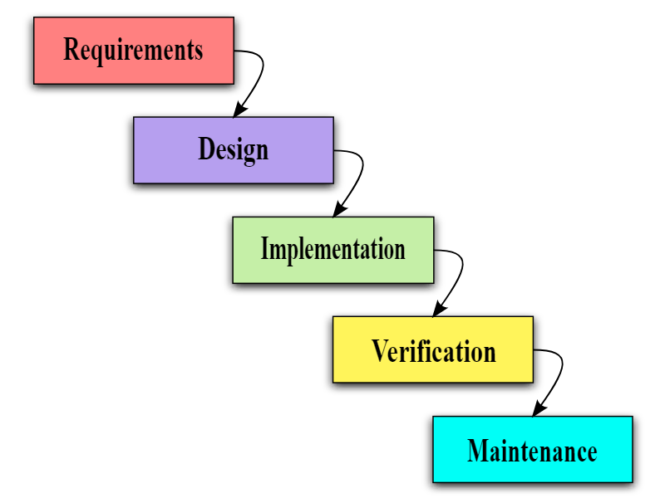
Development Process Waterfall
Why did we used it?
Easy to flaw.
It can be implemented for any size of project.
Testing is done at every stage.

Slide 6
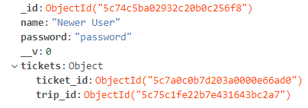
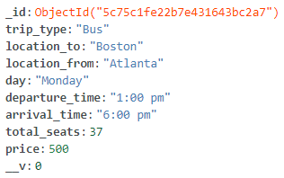
IMPLEMENTATION
Languages used
HTML, CSS, and Javascript.
AngularJS, Bootstrap CSS
Database used
NoSQL > MongoDB
API
Created our own
Node.js, Express.js, and Mongoose

Slide 7
REQUIREMENT
Elicitation
Visualization - As a group we spent a long time building up to our project by drawing diagrams and deciding how to proceed visually from point to point.
Collecting data - For the front-end we spent many hours looking at other websites and navigating through them to see how we should proceed with our own website.
Deciding the appropriate tools to use for this particular project was hard because we all come from different programming language backgrounds (except java), however, building a website solely with java can be cumbersome.

Slide 8
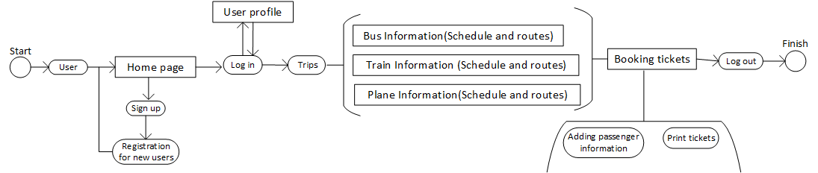
REQUIREMENT
Context diagram/Activities diagram

Slide 9
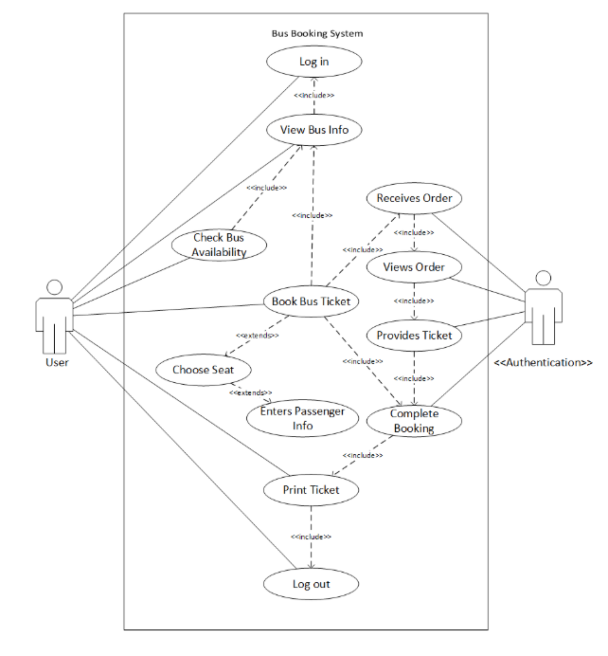
REQUIREMENT
Use Cases and Use cases diagram
Actors: User & Authentication
User: Log in, View Bus Info, Check Bus Availability, Book Bus Ticket, Choose Seat, Enter Passenger Info, Complete Booking, Print Ticket, Log out.
Authentication: Receives Order, Views Order, Provides Ticket, Complete Booking
Use cases diagram of Bus Booking System

Slide 10
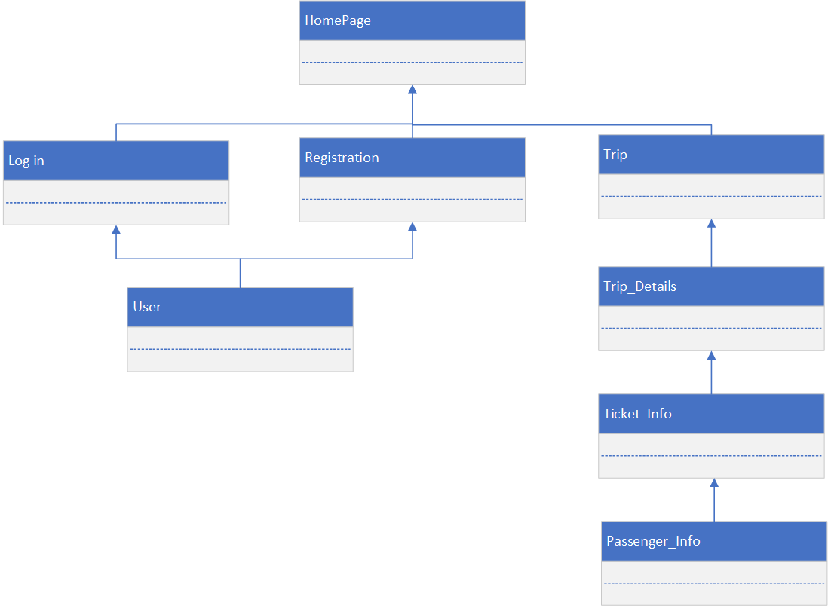
CLASS DIAGRAM
Design
Classes: 6
HomePage
Log In
Registration
User(User Profile)
Trip
Trip_details
Ticket_Info
Passenger_Info

Slide 11
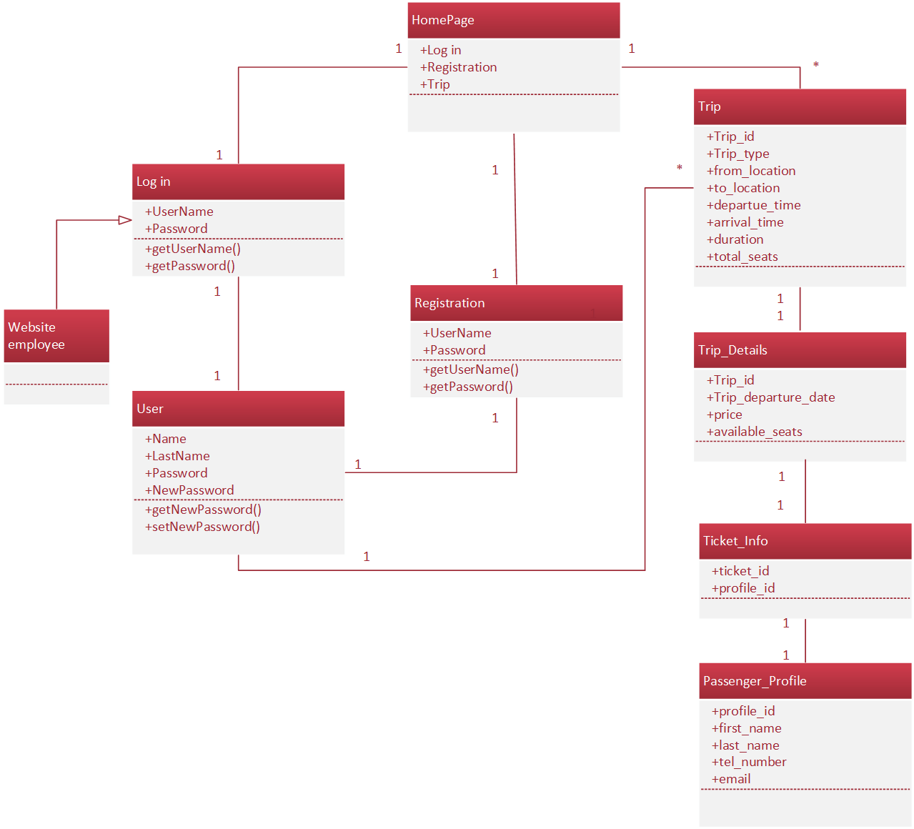
CLASS DIAGRAM
Relationship type between objects is Association.
Directed Association between Website employee & Log in.
Multiplicity almost between every object is equal to one to one.
HomePage and Trips & User and Trips have one to many.

Slide 12
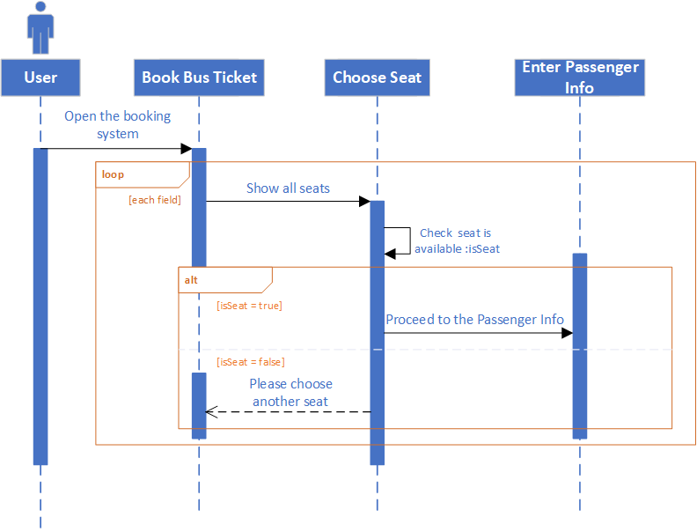
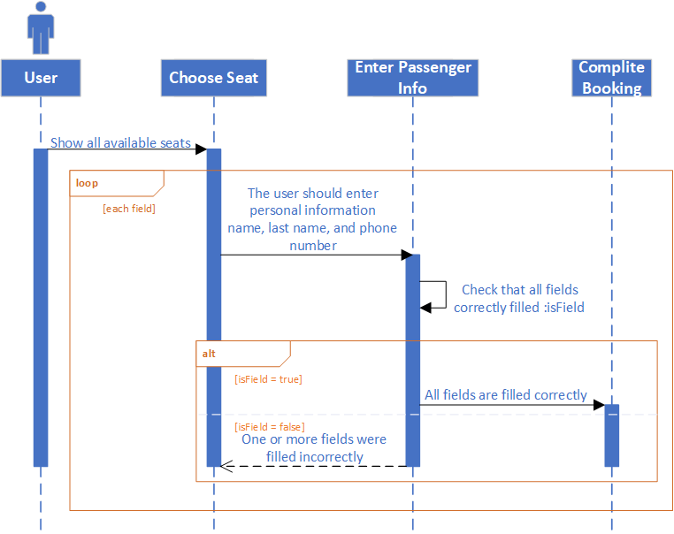
SEQUENCE DIAGRAM
Choose seat
Entering Passenger Information

Slide 13
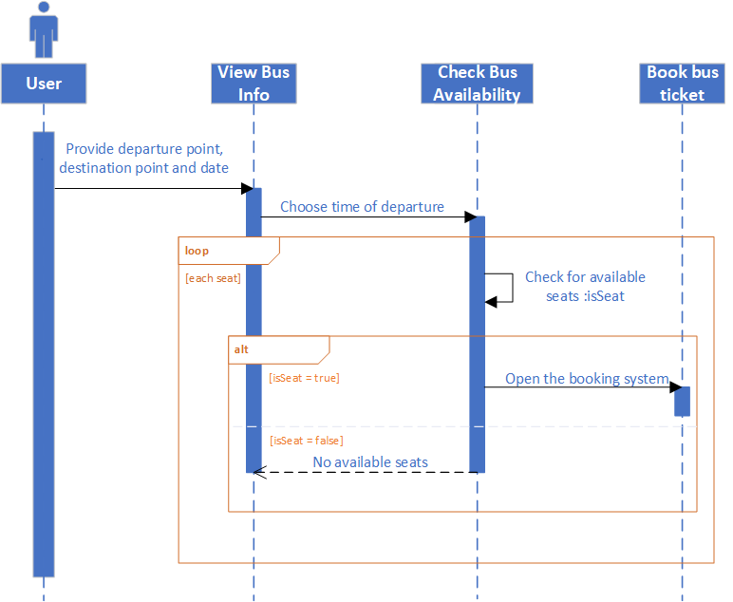
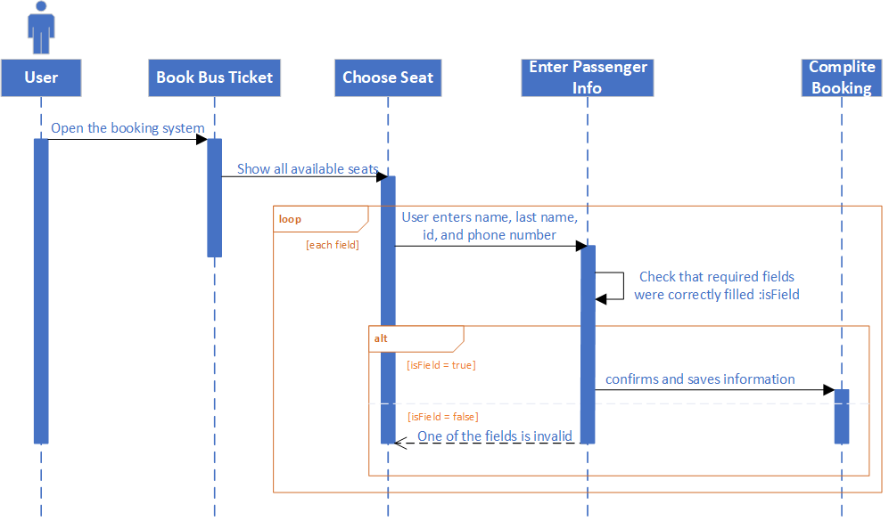
SEQUENCE DIAGRAM
Check Bus Availability
Booking Tickets

Slide 14
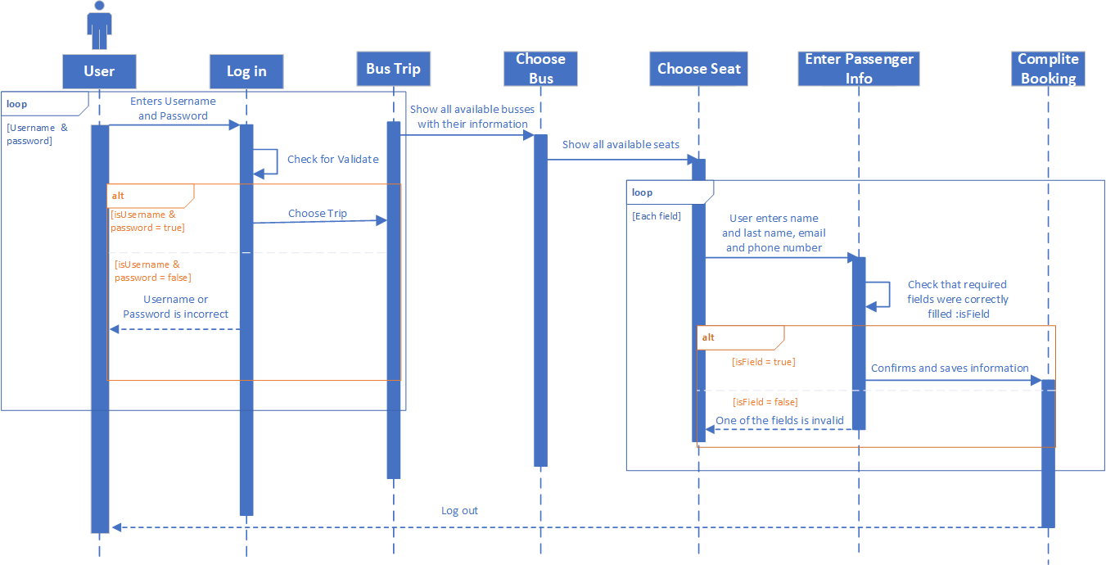
SEQUENCE DIAGRAM

Slide 15
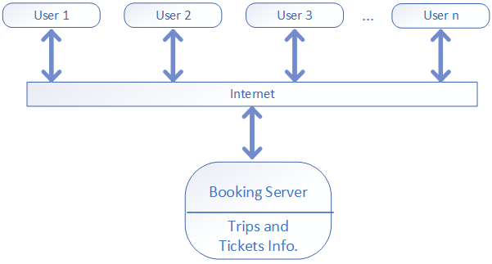
ARCHITECTURE
Client-Server Architecture

Slide 16
Client-Server Architecture
Why did we chose it?
It has a simple architecture
It allows clients to access the website whenever a person needs it.
This architecture was designed to not have difficulty providing needed service to clients.

Slide 17
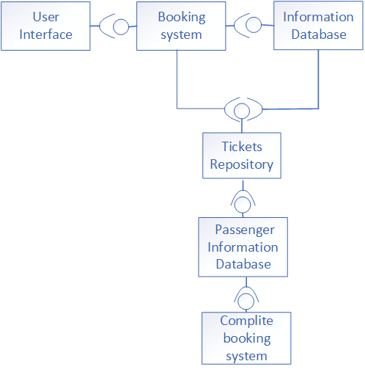
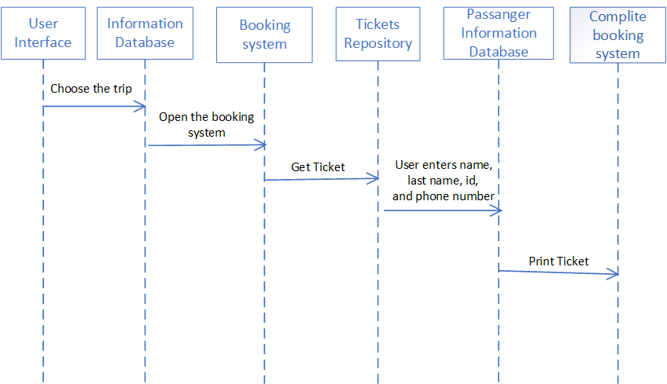
ARCHITECTURE
Logical View
Process View

Slide 18
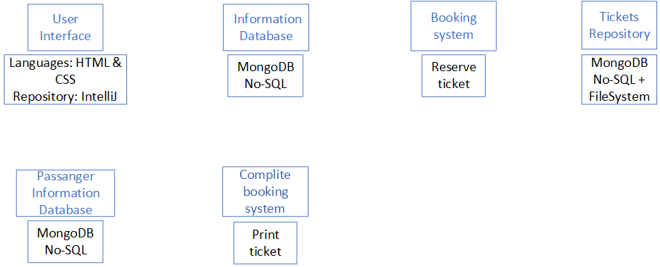
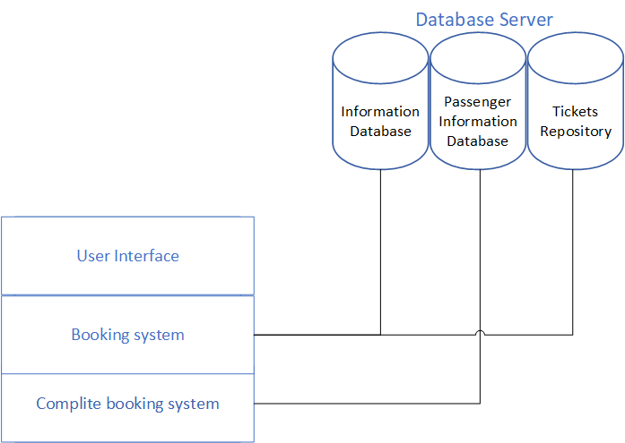
ARCHITECTURE
Development View
Physical View

Slide 19
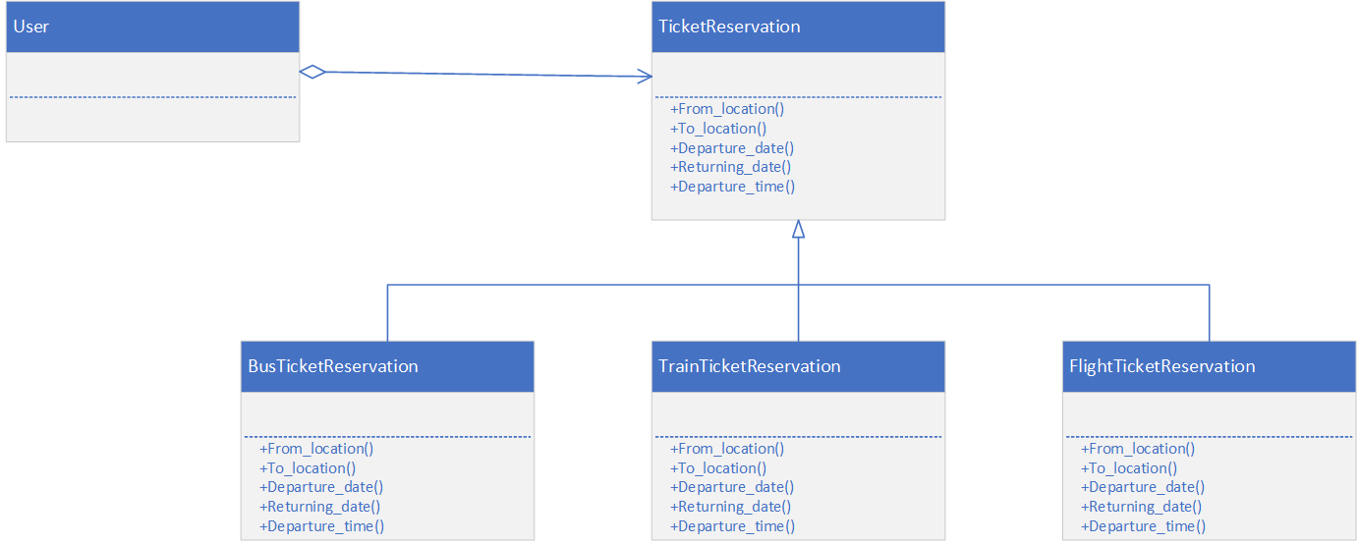
DESIGN PATTERNS
Strategy Pattern

Slide 20
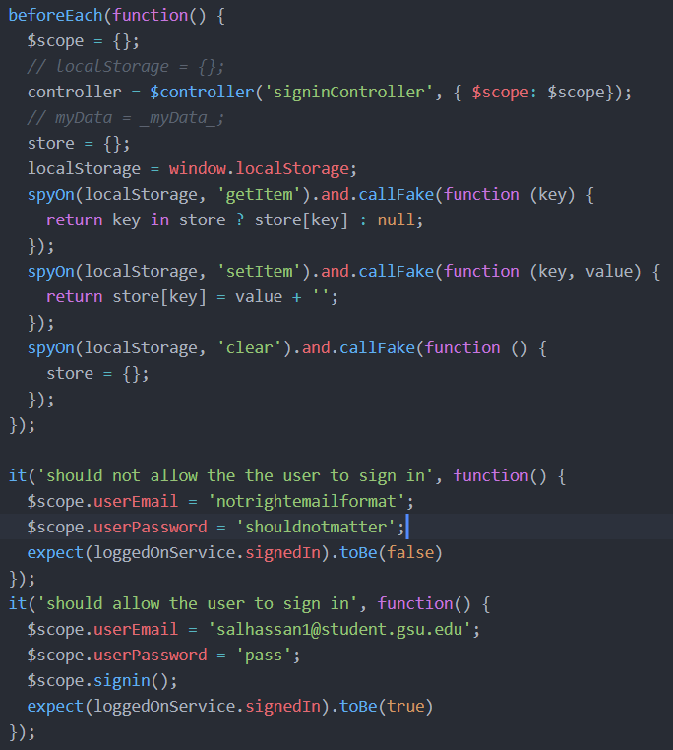
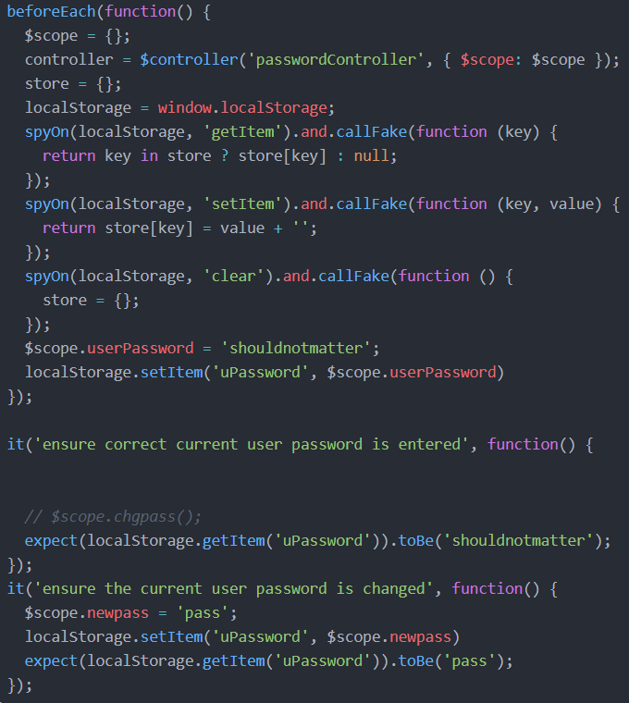
TESTING
Functional
White Box

Slide 21

DEMONSTRATION
https://5aleh.github.io

